Slide 1
THE IMPORTANCE OF BUDGET PLANNING

Slide 2
WHY BUDGET PLANNING
IS IMPORTANT?
Giving a complete picture of your financial situation
Make you more cautious in your spending, No wasting of money on nonessential things.
Avoiding financial problems (debts and shortages)
Allowing you to have a debt-free future, Giving peace of mind and happy life.
Giving an opportunity to support God’s work more generously.

Slide 3
Giving a complete picture of your financial situation

Slide 4
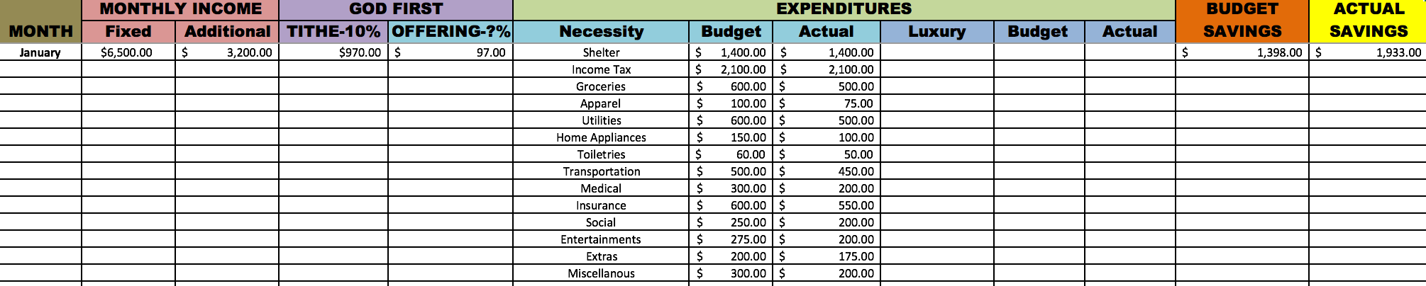
two major components needed in making budget:
Income
Expenditures

Slide 5
INCOME
a.Fixed salary
b. Additional earning
c. Extra earnings

Slide 6

WHERE DOES OUR MONEY COME FROM?

Slide 7


One sixth of the earth belongs to Queen Elizabeth II, head of state of the United Kingdom and of 31 other states and territories legally. Her properties worth $33,000,000,000,000.- or about £17,600,000,000,000.-
The rest of the earth belong to 15 Biggest Landowners.
Who owns the earth?
Universal Free Press stated:
Legal but not Absolute owners.

Slide 8
PSALM 24:1
“The earth is the LORD's, and the fulness thereof; the world, and they that dwell therein.”
The Real Absolute Owner
of the earth?
BIBLE:
God is the
Absolute owner.

Slide 9

  God is the Owner because of . . .
God is the Owner of everything
CREATION

Slide 10
GENESIS 1:1 –”In the beginning God created the heaven and the earth.”
GOD CREATED

Slide 11
“Bereshit bara ELOHIM”
“bara” -– “describing the Divine activity; is used exclusively of God.

Slide 12

PSALM 33:9 –”For He spoke, and it came to be; He commanded, and it stood firm.”
How did He create them?
spoke,
commanded

Slide 13
PSALM 33:6 –
By the word of the LORD were the heavens made; and all the host of them by the breath of his mouth.”
How did He create them?
Word of God,
the Breath of His Mouth

Slide 14

As the Creator God established the Stewardship Program on earth.
God established the Stewardship Program
God, the Owner,
Man, a steward

Slide 15

God assigned mankind the steward of His belongings, Rule over the fish in the sea and the birds in the sky and over every living creature that moves on the ground.
God established the Stewardship Program
Rule over the fish, birds &
every living creature

Slide 16
GENESIS 2:15 - ”And the LORD God took the man, and put him into the garden of Eden to dress it and to keep it.”
God established the Stewardship Program
To dress and keep the Garden

Slide 17
HOW ABSOLUTE IS HIS OWNERSHIP OF THE EARTH?
OWNERSHIP

Slide 18

PSALM 24:1 –“The earth is the LORD'S, and the fulness thereof; the world, and they that dwell therein.”
GOD IS THE OWNER OF EVERYTHING ABSOLUTELY
fulness thereof

Slide 19

bauxite, coal, iron ore, copper, tin, gold, silver, uranium, nickel, tungsten, rare earth elements, mineral sands, lead, zinc, diamonds, natural gas, petroleum
note:
Australia is the world's largest net exporter of coal accounting for 29% of global coal exports.
GOD IS THE OWNER OF ANYTHING IN NATURE ABSOLUTELY
AUSTRALIA

Slide 20
coal, iron ore, petroleum, natural gas, mercury, tin, tungsten, antimony, manganese, molybdenum, vanadium, magnetite, aluminum,lead, zinc, rare earth elements, uranium, hydropower potential (world's largest), arable land.
GOD IS THE OWNER OF ANYTHING IN NATURE ABSOLUTELY
CHINA

Slide 21
gold, chromium, antimony, coal, iron ore, manganese, nickel, phosphates, tin, rare earth elements, uranium, gem diamonds, platinum, copper, vanadium, salt, natural gas.
GOD IS THE OWNER OF ANYTHING IN NATURE ABSOLUTELY
SOUTH AFRICA

Slide 22
coal, copper, lead, molybdenum, phosphates, rare earth elements, uranium, bauxite, gold, iron, mercury, nickel, potash, silver, tungsten, zinc, petroleum, natural gas, timber, arable land
note:
the US has the world's largest coal reserves with 491 billion short tons accounting for 27% of the world's total
GOD IS THE OWNER OF ANYTHING IN NATURE ABSOLUTELY
USA

Slide 23
iron ore, nickel, zinc, copper, gold, lead, rare earth elements, molybdenum, potash, diamonds, silver,fish, timber, wildlife, coal, petroleum, natural gas, hydropower
GOD IS THE OWNER OF ANYTHING IN NATURE ABSOLUTELY
CANADA

Slide 24
bauxite, gold, iron ore, manganese, nickel, phosphates, platinum, tin, rare earth elements, uranium, petroleum, hydropower, timber.
GOD IS THE OWNER OF ANYTHING IN NATURE ABSOLUTELY
BRAZIL

Slide 25

HAGGAI 2:8 –“The silver is mine, and the gold is mine, saith the LORD of hosts.”
GOD CONFIRMED WHAT HE OWNS!
Silver & Gold

Slide 26
BEWARE!

Slide 27
Forget not
DEUTERONOMY 8:11
“Beware that thou forget not the LORD thy God, in not keeping his commandments, and his judgments, and his statutes, which I command thee this day:”

Slide 28
Forget not
DEUTERONOMY 8:12
Lest when thou hast eaten and art full, and hast built goodly houses, and dwelt therein;

Slide 29
Forget not
DEUTERONOMY 8:13
And when thy herds and thy flocks multiply, and thy silver and thy gold is multiplied, and all that thou hast is multiplied;

Slide 30
Forget not
DEUTERONOMY 8:17
And thou say in thine heart, My power and the might of mine hand hath gotten me this wealth.

Slide 31
Forget not
DEUTERONOMY 8:18
But thou shalt remember the LORD thy God: for it is He that giveth thee power to get wealth, that He may establish His covenant which He sware unto thy fathers, as it is this day.

Slide 32

Does God have the right to ask us to put Him first?
Absolutely, Yes!

Slide 33
Knowing that God owns everything, whenever we receive our earnings, we have to acknowledge it.

Slide 34
How do we show our acknowledgment that He owns everything?

Slide 35
Honour the LORD with thy substance
PROVERBS 3:9,10
“Honour the LORD with thy substance, and with the firstfruits of all thine increase:So shall thy barns be filled with plenty, and thy presses shall burst out with new wine.”

Slide 36
Honour the LORD with thy substance
MALACHI 3:10
“Bring ye all the tithes into the storehouse, that there may be meat in mine house, and prove me now herewith, saith the LORD of hosts, if I will not open you the windows of heaven, and pour you out a blessing, that there shall not be room enough to receive it.”

Slide 37
Ye have robbed me
MALACHI 3:8
Will a man rob God? Yet ye have robbed Me. But ye say, Wherein have we robbed Thee? In tithes and offerings.

Slide 38
Ye are cursed
MALACHI 3:9
Ye are cursed with a curse: for ye have robbed me, even this whole nation.

Slide 39
I will rebuke the devourer
MALACHI 3:9
And I will rebuke the devourer for your sakes, and he shall not destroy the fruits of your ground; neither shall your vine cast her fruit before the time in the field, saith the LORD of hosts.

Slide 40
all nations shall call you blessed
MALACHI 3:11
And all nations shall call you blessed: for ye shall be a delightsome land, saith the LORD of hosts.

Slide 41
GOD FIRST
a.Tithe - 10%
b. Offerings (?) %
c. Mission Projects

Slide 42
God has miraculous inexhaustible supplies

Slide 43
BIBLE STORIES
  Manna
  Quails
  Eliah - raven
  Elijah - poor widow
  More than 5,000 people being fed with 5 breads and 2 fish - 12 basket left.
  Peter’s fish with coins in their mouths.
  153 fish in the disciples’ net.
  Etc.

Slide 44
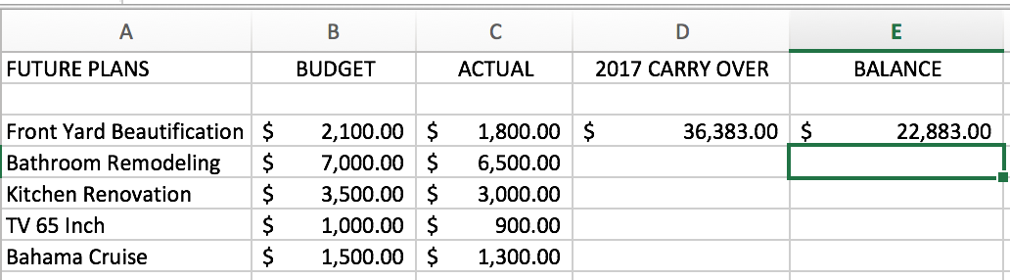
EXPENDITURES
a.Basic Necessity
b. Luxury things
c. Future plans

Slide 45
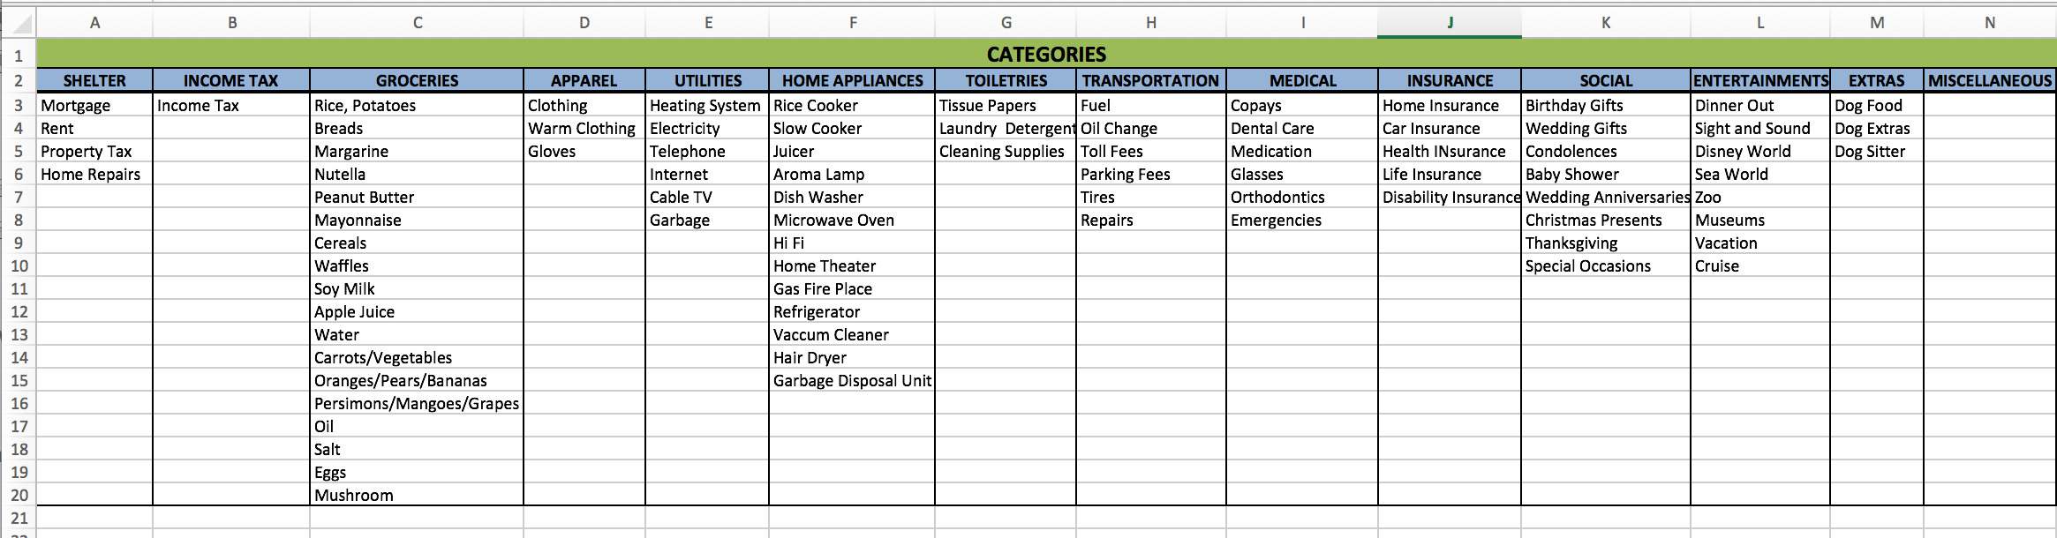
BASIC NECESSITY

Slide 46
Making
Categories

Slide 47
GROCERIES
Rice, Potatoes
Breads
Margarine
Nutella
Peanut Butter
Mayonnaise
Cereals
Waffles
Soy Milk
Apple Juice
Water
Carrots/Vegetables
Oranges/Pears/Bananas
Persimons/Mangoes/Grapes
Oil
Salt
Eggs
Mushroom
THE LORD’S
Tithe
Offerings
HOME APPLIANCES
Rice Cooker
Slow Cooker
Juicer
Aroma Lamp
Dish Washer
Microwave Oven
Hi Fi
Home Theater
Gas Fire Place
Refrigerator
Vaccum Cleaner
Hair Dryer
Garbage Disposal Unit
ENTERTAINMENTS
Dinner Out
Sight and Sound
Disney World
Sea World
Zoo
Museums
Vacation
Cruise
MEDICAL
Copays
Dental Care
Medication
Glasses
Orthodontics
Emergencies
SHELTER
Mortgage
Rent
Property Tax
Home Repairs
APPAREL
Clothing
Warm Clothing, Gloves, etc.
INSURANCE
Home Insurance
Car Insurance
Health INsurance
Life Insurance
Disability Insurance
EXTRAS
Dog Food
Dog Extras
Dog Sitter
TOILETRIES
Tissue Papers
Laundry Detergent
Cleaning Supplies
UTILITIES
Heating System
Electricity
Telephone
Internet
Cable TV
Garbage
TRANSPORTATION
Fuel
Oil Change
Toll Fees
Parking Fees
Tires
Repairs
SOCIAL
Birthday Gifts
Wedding Gifts
Condolences
Baby Shower
Wedding Anniversaries
Christmas Presents
Thanksgiving
Special Occasions
INCOME TAX
Income Tax
MISCELLANEOUS

Slide 48
THE LORD’S
Tithe
Offerings
WHAT IS YOUR PLAN?
TITHE = 10%
OFFERINGS =(?)%

Slide 49
SHELTER
Mortgage
Rent
Property Tax
Home Repairs

Slide 50
GROCERIES
Rice, Potatoes
Breads
Margarine
Nutella
Peanut Butter
Mayonnaise
Cereals
Waffles
Soy Milk
Apple Juice
Water
Carrots/Vegetables
Oranges/Pears/Bananas
Persimons/Mangoes/Grapes
Oil
Salt
Eggs
Mushroom

Slide 51
APPAREL
Clothing
Warm Clothing, Gloves, etc.

Slide 52
INCOME TAX
Income Tax

Slide 53
UTILITIES
Heating System
Electricity
Telephone
Internet
Cable TV
Garbage

Slide 54
HOME APPLIANCES
Rice Cooker
Slow Cooker
Juicer
Aroma Lamp
Dish Washer
Microwave Oven
Hi Fi
Home Theater
Gas Fire Place
Refrigerator
Vaccum Cleaner
Hair Dryer
Garbage Disposal Unit

Slide 55
TOILETRIES
Tissue Papers
Laundry Detergent
Cleaning Supplies

Slide 56
TRANSPORTATION
Fuel
Oil Change
Toll Fees
Parking Fees
Tires
Repairs

Slide 57
MEDICAL
Copays
Dental Care
Medication
Glasses
Orthodontics
Emergencies

Slide 58
INSURANCE
Home Insurance
Car Insurance
Health Insurance
Life Insurance
Disability Insurance

Slide 59
SOCIAL
Birthday Gifts
Wedding Gifts
Condolences
Baby Shower
Wedding Anniversaries
Christmas Presents
Thanksgiving
Special Occasions

Slide 60
ENTERTAINMENTS
Dinner Out
Sight and Sound
Disney World
Sea World
Zoo
Museums
Vacation
Cruise

Slide 61
EXTRAS
Dog Food
Dog Extras
Dog Sitter

Slide 62
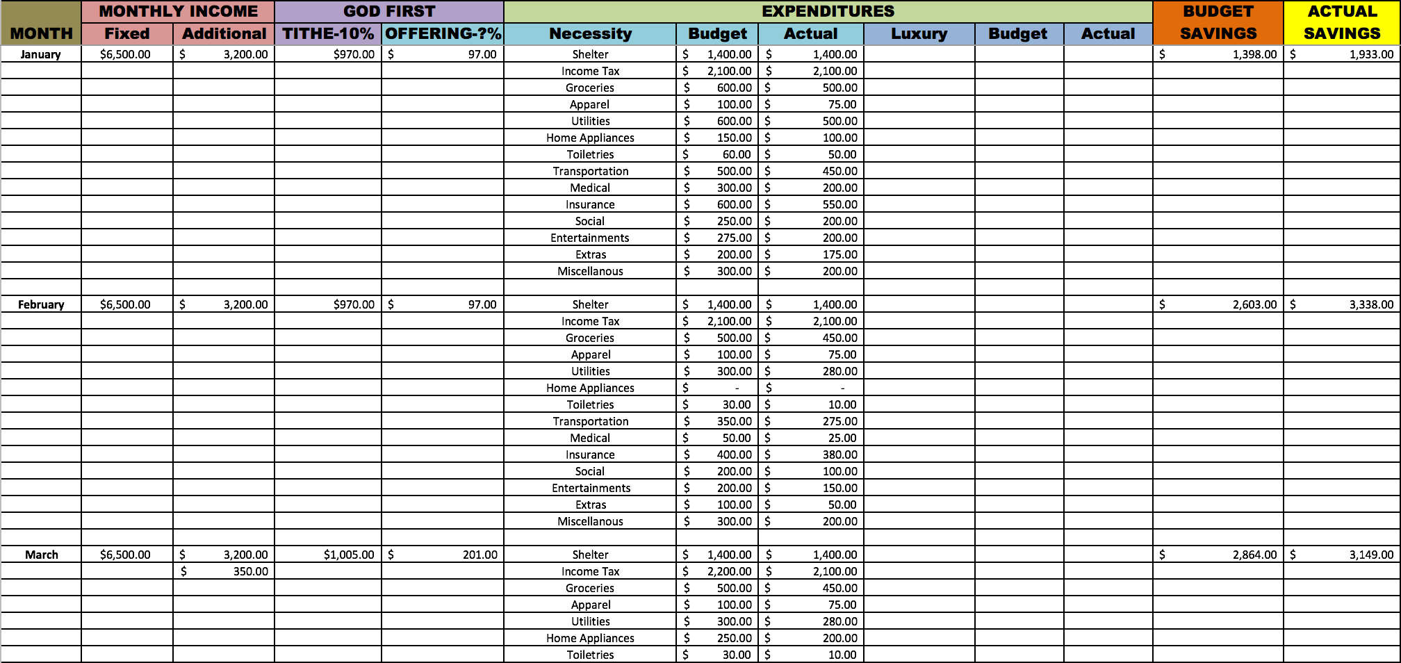

Slide 63
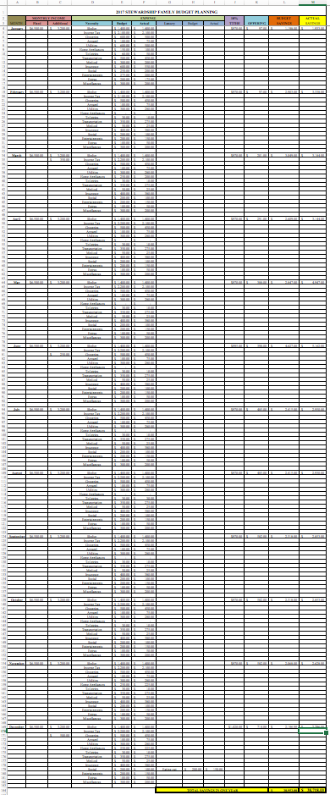

Slide 64
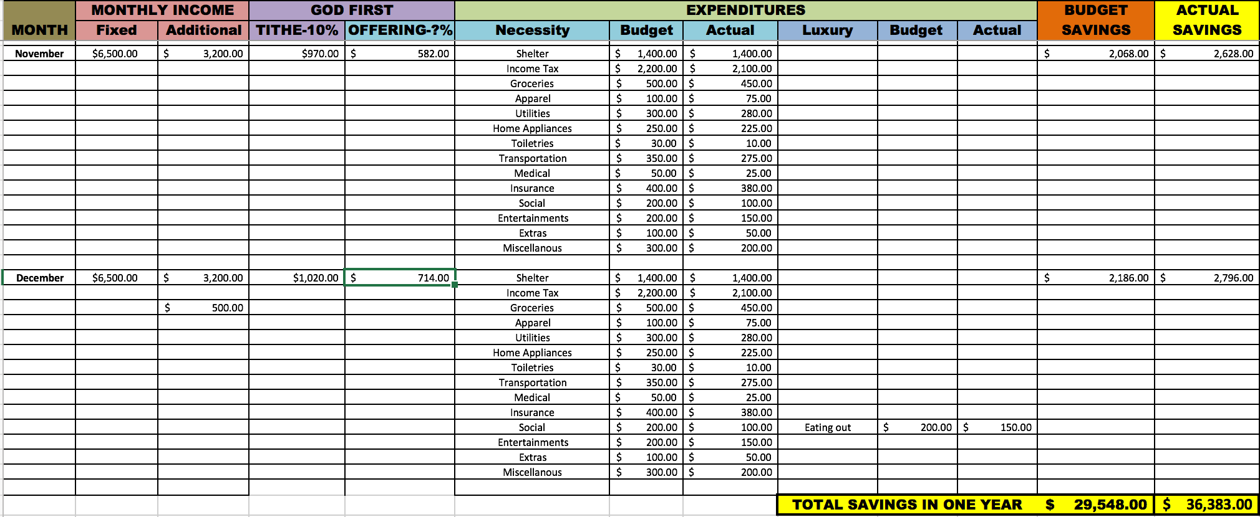

Slide 65
Are we going to have less if we give GOD first?

Slide 66

“It is not returning to the Lord His own that makes men poor; . . .”
Ellen G. White, Counsels on Stewaardship, p. 36.

Slide 67

“. . . withholding tends to poverty.”
Ellen G. White, Counsels on Stewaardship, p. 36.

Slide 68

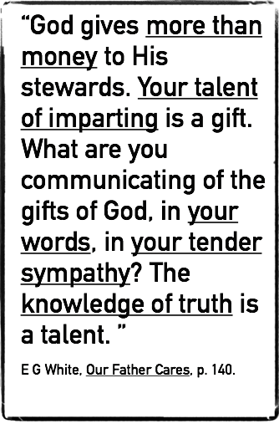
What does He give?
Your talent of imparting.
your words.
your tender sympathy.
The knowledge of truth.

Slide 69
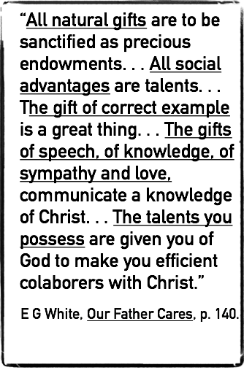
What else does He give?
Your talent of imparting.
your words.
your tender sympathy.
The knowledge of truth.
All natural gifts
All social advantages
The gift of correct example
The gifts of speech, of knowledge, of sympathy and love
The talents you possess

Slide 70
What else does He give?
Sunshine
Oxygen
Life

Slide 71
What is the constant test of our affections?

Slide 72

“Money is a constant test of the affections.”
Ellen G. White, Adventist Home, p. 372.

Slide 73
Make you more cautious in your spending, No wasting of money on nonessential things.

Slide 74

“All should learn how to keep accounts. Some neglect this work as nonessential, but this is wrong. All expenses should be accurately stated.”
Ellen G. White, Adventist Home, p. 374.

Slide 75


IMPORTANT TIPS:
Before going for shopping, make a list of things to buy, follow your budget carefully.
Do not buy things that are not on the list.
Watch out of your spending, If your expense is over than your budget, return some of your groceries back to their shelves and spend only what is budgeted.
Use cash rather than credit or debit card,
Nothing wrong with the use of your debit or Credit card, as long as you know how much your budget is on the list, so you stop piling up your groceries and return the things that is not listed.
Do not bring children.
Eat before go shopping. When you are hungry, you spend extra expense.
You will be able to save a lot of your money and keep your budget in good shape.

Slide 76


TIPS BEFORE BUYING THINGS, ASK QUESTIONS:
“Do I really need that product?”
“Have I bought the same thing before, and I have not use it, even do not know where I kept it?”
‘Am I making an impulse buying rather than a planned one?”
“Do I have enough money to support my buying?”
“Will my buying cause a buyer’s regret later on?
Am I a good steward in managing God’s money wisely?

Slide 77

““The Lord has been pleased to present before me the evils which result from spendthrift habits, that I might admonish parents to teach their children strict economy. Teach them that money spent for that which they do not need is perverted from its proper use.”
Ellen G. White, Adventist Home, p. 374.

Slide 78

“I was shown that you, my brother and sister, have much to learn. You have not lived within your means. You have not learned to economize. If you earn high wages, you do not know how to make it go as far as possible. You consult taste or appetite instead of prudence. At times you expend money for a quality of food in which your brethren cannot afford to indulge. Dollars slip from your pocket very easily.... Self-denial is a lesson which you both have yet to learn.”
Ellen G. White, Adventist Home, p. 376.

Slide 79
Avoiding financial problems (debts and shortages)

Slide 80

“BE WATCHFUL”
You bought your 40” Smart TV, it was the biggest on sale then and you are satisfied with it.
But after sometime you saw 55” Smart TV on sale, you were tempted to have that.
Do you want to buy it?
Your impulse says “ buy it, it has more features and bigger is better.”
The story repeats itself, later they are promoting 70”, then 80”, what shall you do?
You should train your brain to say “No” to impulse buying.
Do not linger too long to that promotional product.
Leave the temptation site as quickly as possible. Leave that temptation alone.
You will have a better savings, a better future and giving you peace of mind and a better life.

Slide 81
“The Lord has been pleased to present before me the evils which result from spendthrift habits, that I might admonish parents to teach their children strict economy. Teach them that money spent for that which they do not need is perverted from its proper use.”
Ellen G. White, Adventist Home, p. 374.

Slide 82

“All must practice economy. No worker should manage his affairs in a way to incur debt.”
Ellen G. White, Manual for Canvassers, p. 65,

Slide 83
Allowing you to have a debt-free future, Giving peace of mind and happy life.

Slide 84

“BE WATCHFUL WITH YOUR CREDIT/DEBIT CARDS
Credit card on one hand can be very helpful and convenient if it is used prudently, but on the other hand it can be a threat to your financial safety.
When you go for shopping, use cash rather than credit or debit card,
If possible leave your card/s at home.
Bring your cash, it is a bit of incovenient, but in the end it will save you a lot of financial troubles.
When they offer big sale, that big sale does not mean that you are saving your money, the truth is you are spending your money.
Do not keep your credit card details on file at any company or shopping store.

Slide 85

“BE WATCHFUL WITH ONLINE SHOPPING
Do not easily be tempted by TV advertizements: “If you call within 10 minutes, we will double the offer.”
Be careful with the online advertizement from any electronic company purchase who is very tempting by offering conveniency, with no handling charges, and overnight shipment.
If you have to make a purchase online, make sure you have made the plan to buy the needed and planned product.
Ask, “do we have enough cash flow to buy it without sacrificing other need that is more important?’
‘Can we wait until our cash flow is safe enough to buy?’
Search directly the product and compare prices with other online shops to get a better price and a better product.

Slide 86
Giving an opportunity to support God’s work more generously.

Slide 87

“In commissioning His disciples to go “into all the world, and preach the gospel to every creature,” Christ assigned to men the work of extending the knowledge of His grace. But while some go forth to preach, He calls upon others to answer His claims upon them for offerings, with which to support His cause in the earth.”
Ellen G. White, Counsels on Stewaardship, p. 15.

Slide 88

“He has placed means in the hands of men, that His divine gifts may flow through human channels in doing the work appointed us in saving our fellow men.”
Ellen G. White, Counsels on Stewaardship, p. 15.

Slide 89
Putting God first and God will bless our earnings.

Slide 90
GOD FIRST
MATTHEW 6:33
“But seek ye first the kingdom of God, and his righteousness; and all these things shall be added unto you.”

Slide 91
If we honour the LORD with our substance, what will happen to us?

Slide 92
God will fill our barns with plenty,
God will make our presses burst out with new wine.
God will open the windows of heaven, and pour out a blessing, that there shall not be room enough to receive it.

Slide 93
How do we seek first the Kingdom of GOD?

Slide 94
Put first the priorities of GOD’s Kingdom.

Slide 95
What are the priorities of God’s Kingdom?

Slide 96
GOD FIRST
1. Advancing His work. CS36

Slide 97

“He supplies men with resources, that by their gifts and offerings they may keep His work advancing.”
Ellen G. White, Counsels on Stewaardship, p. 36.

Slide 98

“To accomplish this work, means is needed. I know that times are hard, money is not plenty; but the truth must be spread, and money to spread it must be placed in the treasury.”
Ellen G. White, Counsels on Stewaardship, p. 39.

Slide 99

“When these are met, by giving to the Lord His own in tithes and offerings, the way will be opened for the world to hear the message that the Lord designs it to hear.”
Ellen G. White, Counsels on Stewaardship, p. 36.

Slide 100

Money - can do good in the salvation of souls.
Money if rightly appropriated, it can do good in the salvation of souls.
Ellen G. White, Counsels on Stewardship, p. 36.

Slide 101

“Money is not necessarily a curse; it is of high value because if rightly appropriated, it can do good in the salvation of souls, in blessing others who are poorer than ourselves..”
Ellen G. White, Adventist Home, p. 372.

Slide 102

“if every church member were imbued with the spirit of self-sacrifice,”
Ellen G. White, Counsels on Stewardship, p. 37.

Slide 103

“there would be no lack of funds for home and foreign missions; our resources would be multiplied;”
Ellen G. White, Counsels on Stewardship, p. 37.

Slide 104

“a thousand doors of usefulness would be opened; and we should be invited to enter.”
Ellen G. White, Counsels on Stewardship, p. 37.

Slide 105
GOD FIRST
2. Sustaining of workers. CS36

Slide 106
“sustaining of workers in the harvest field.”
Ellen G. White, Counsels on Stewardship, p. 37.

Slide 107

“This work of faithfully bringing in all the tithes, that there may be meat in the house of God, would supply laborers for both home and foreign fields.”
Ellen G. White, Counsels on Stewaardship, p. 39.

Slide 108

“Although books and publications upon present truth are pouring out their treasures of knowledge to all parts of the world, yet missionary posts must be established at different points. ”
Ellen G. White, Counsels on Stewaardship, p. 39.

Slide 109

“The living preacher must proclaim the words of life and salvation.”
Ellen G. White, Counsels on Stewaardship, p. 39.

Slide 110

God First,
. . . all these things shall be added unto you!

Slide 111
Enjoy your blessed Future
with Peace of Mind and
Joyful Heart!

